Slide 1
Control Inspection
Contractor: Example Contractor
Client: Example Client
Agreement #111-11-11 dated 01.11.2024
Structure type F6
Construction count: 2 pcs.
Installation address: Sample District, Example Street 137A, pedestrian area
Reporting period: 01.12.2024-31.12.2024

Slide 2
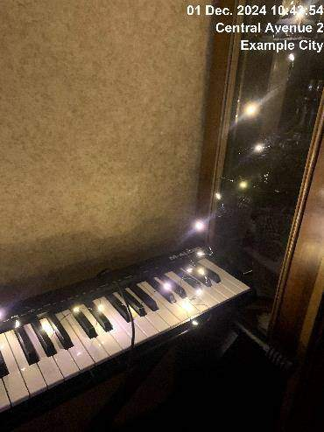
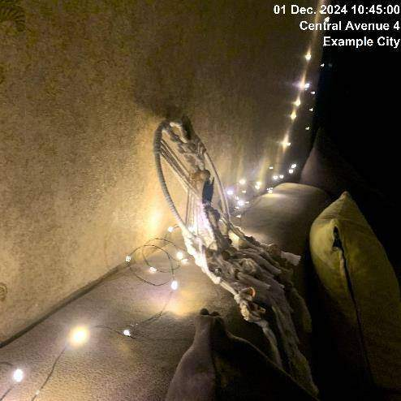
01.12.2024
Construction 1
01.12.2024
Construction 2

Slide 3
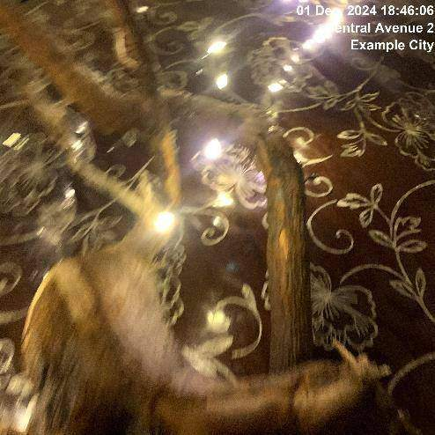
01.12.2024
Construction 3

Slide 4
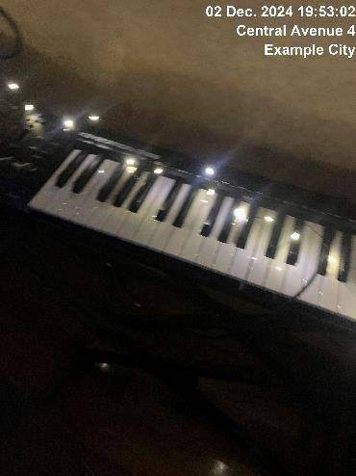
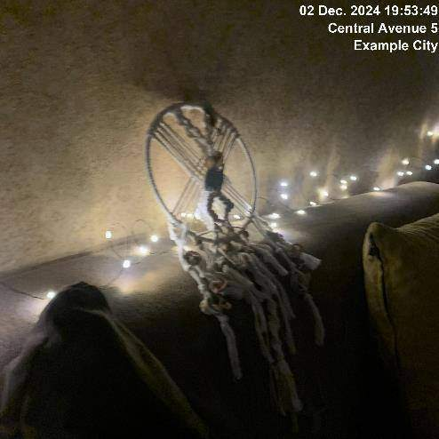
02.12.2024
Construction 1
02.12.2024
Construction 2

Slide 5
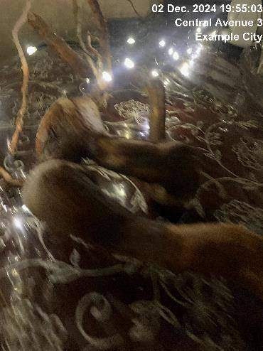
02.12.2024
Construction 3

Slide 6
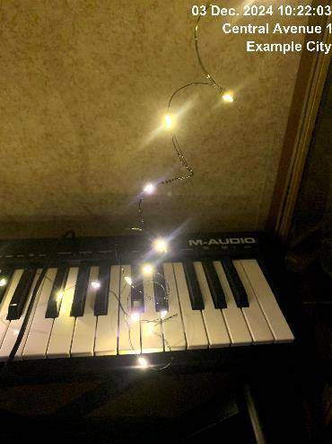
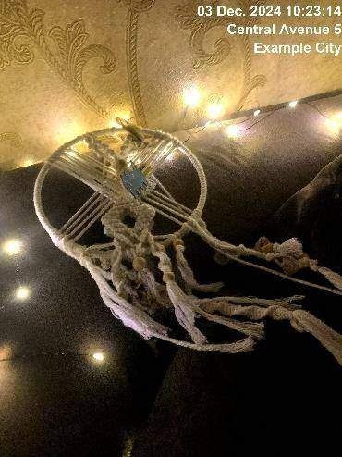

03.12.2024
Construction 1
03.12.2024
Construction 2
03.12.2024
Construction 3
Deep inspection required

Slide 7
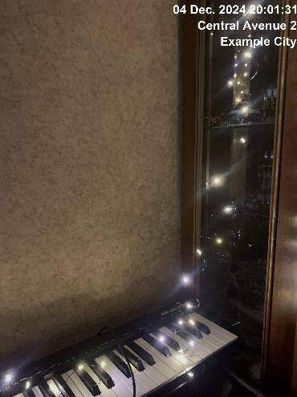
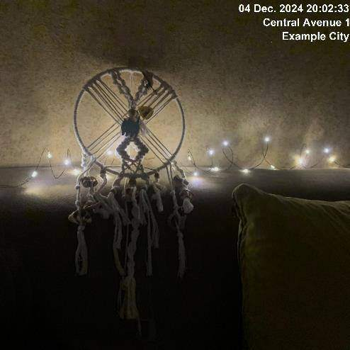
04.12.2024
Construction 1
04.12.2024
Construction 2

Slide 8
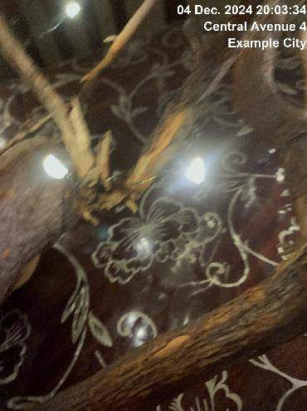
04.12.2024
Construction 3

Slide 9
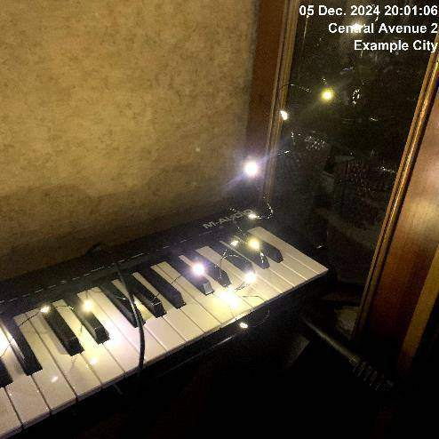
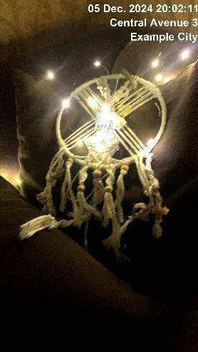

05.12.2024
Construction 1
05.12.2024
Construction 2
05.12.2024
Construction 3

Slide 10
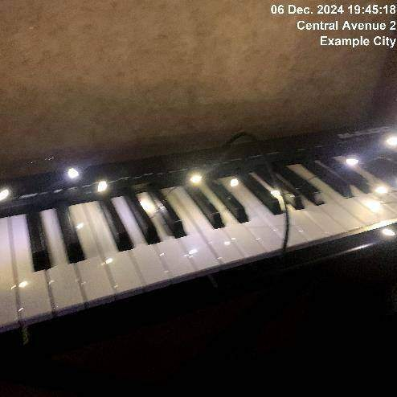
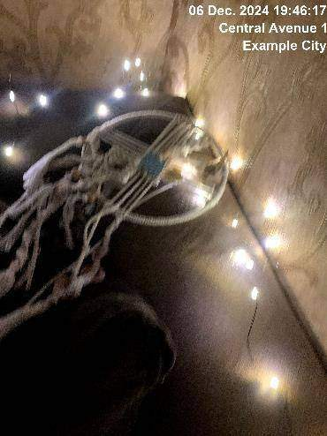
06.12.2024
Construction 1
06.12.2024
Construction 2

Slide 11
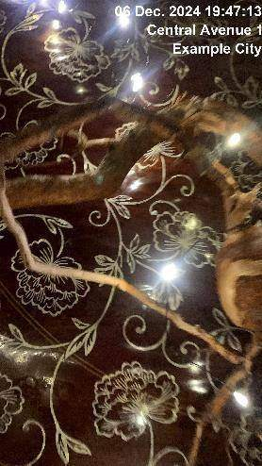
06.12.2024
Construction 3

Slide 12
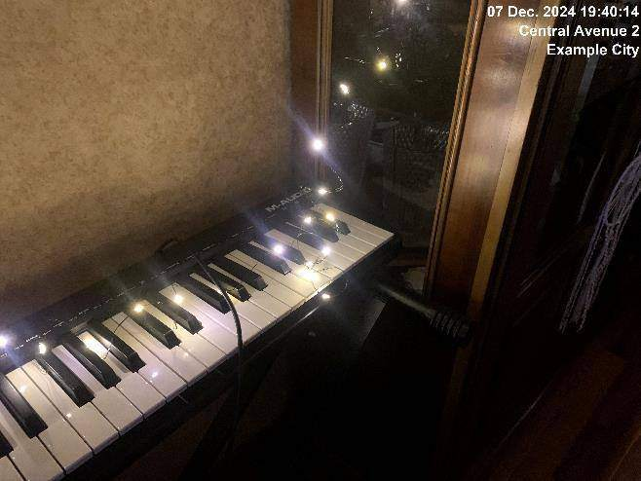
07.12.2024
Construction 1
Snow removal required

Slide 13

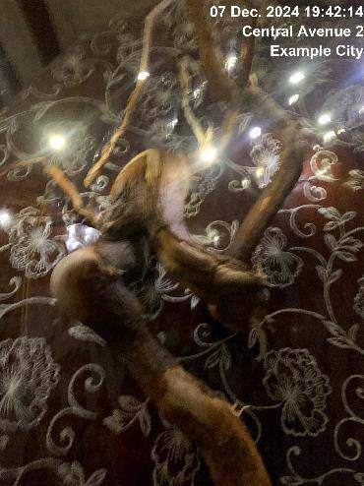
07.12.2024
Construction 2
Snow removal required
07.12.2024
Construction 3
Snow removal required

Slide 14
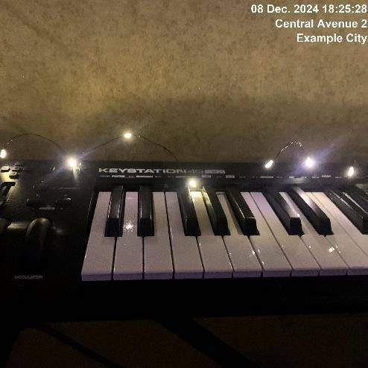
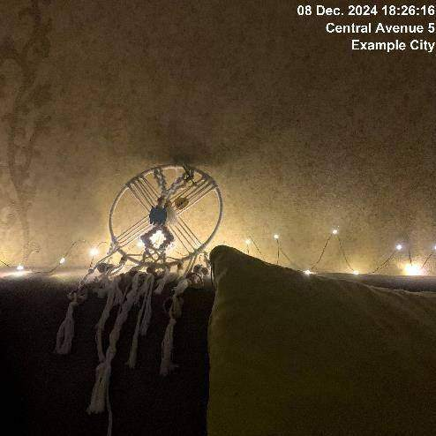
08.12.2024
Construction 1
Surface polishing required
08.12.2024
Construction 2
Surface polishing required

Slide 15
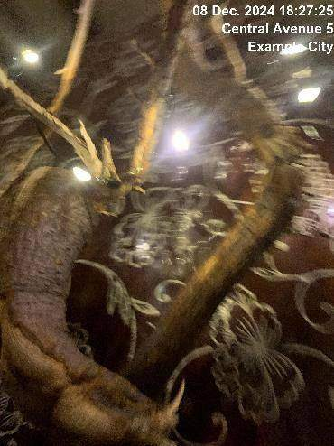
08.12.2024
Construction 3
Surface polishing required

Slide 16
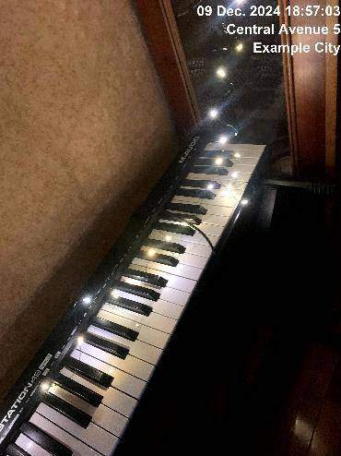
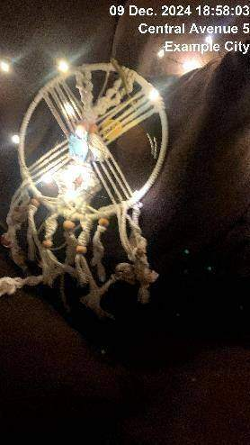
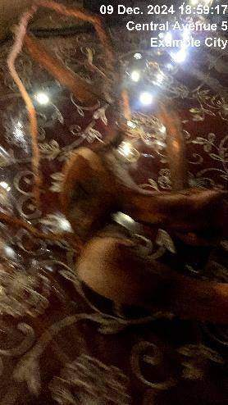
09.12.2024
Construction 1
Snow removal required
09.12.2024
Construction 2
Snow removal required
09.12.2024
Construction 3
Snow removal required

Slide 17
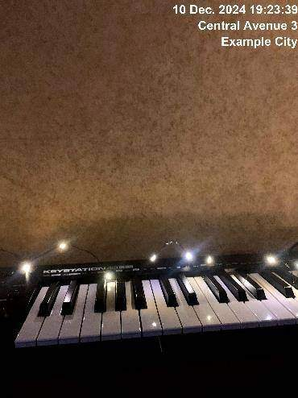
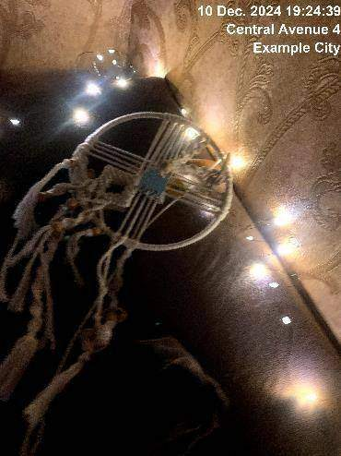
10.12.2024
Construction 1
Partical repair required
10.12.2024
Construction 2

Slide 18
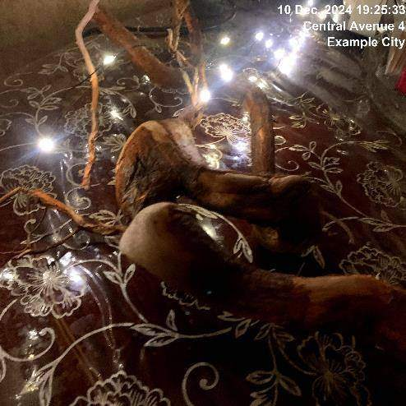
10.12.2024
Construction 3

Slide 19
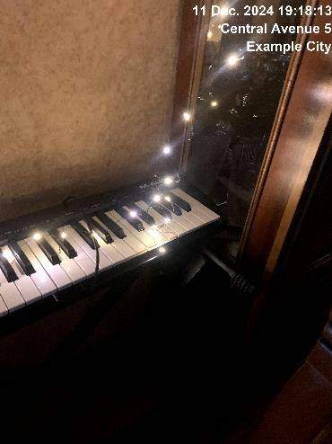
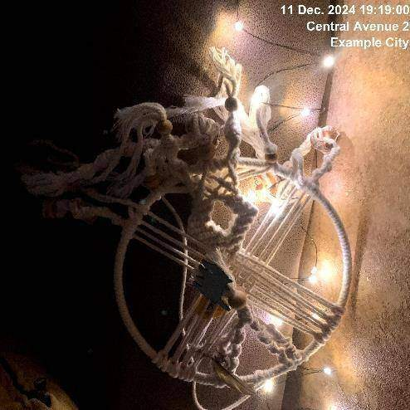
11.12.2024
Construction 1
11.12.2024
Construction 2
Deep inspection required

Slide 20
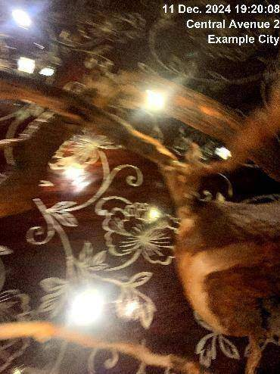
11.12.2024
Construction 3

Slide 21
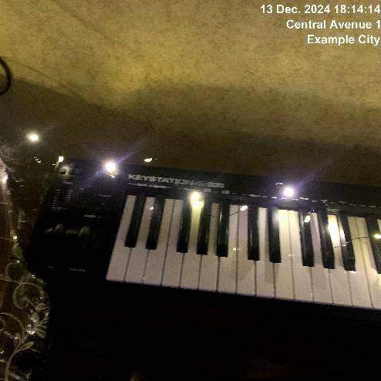
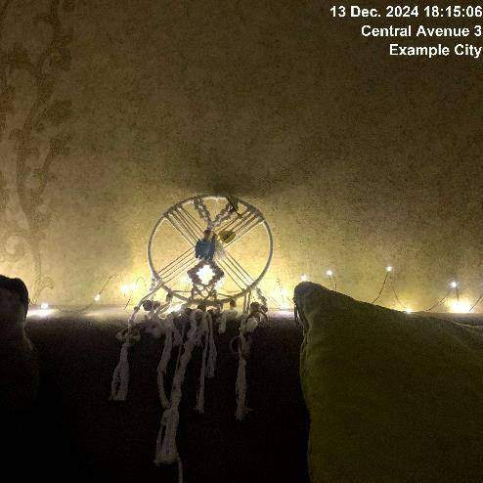
13.12.2024
Construction 1
13.12.2024
Construction 2

Slide 22
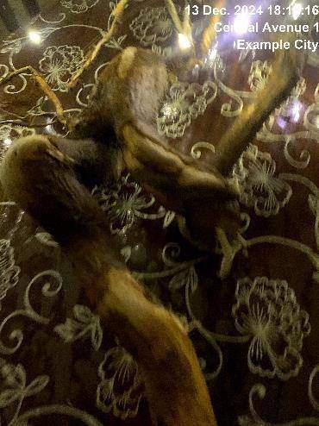
13.12.2024
Construction 3

Slide 23
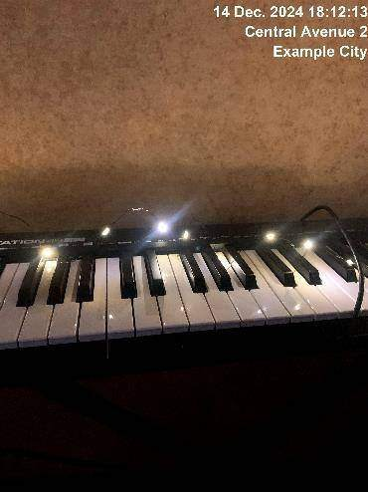
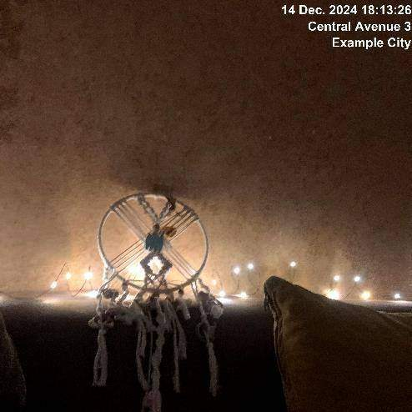
14.12.2024
Construction 1
14.12.2024
Construction 2

Slide 24
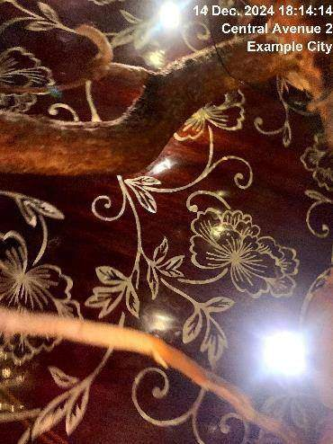
14.12.2024
Construction 3
Partical repair required

Slide 25
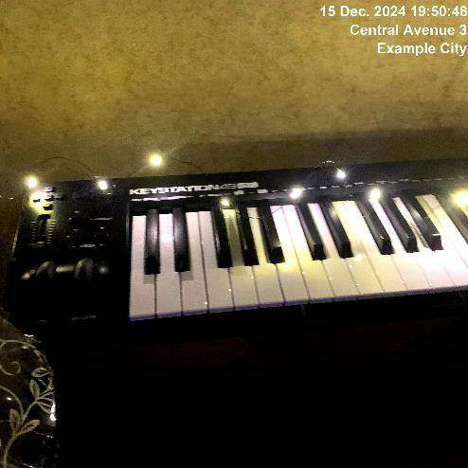
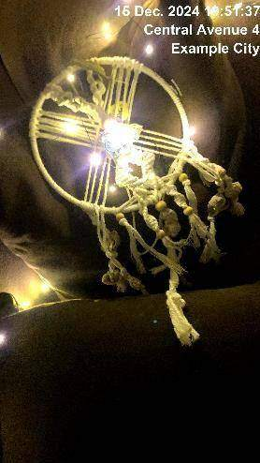
15.12.2024
Construction 1
Snow removal required
15.12.2024
Construction 2
Snow removal required

Slide 26

15.12.2024
Construction 3
Snow removal required

Slide 27
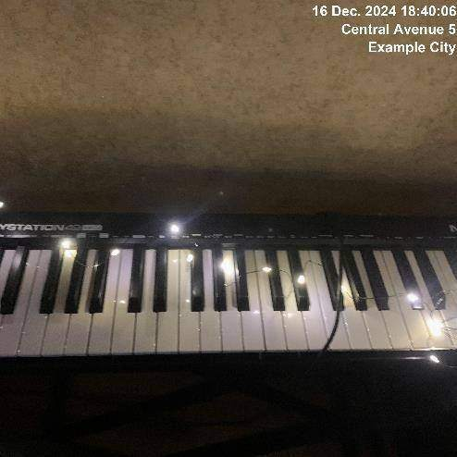
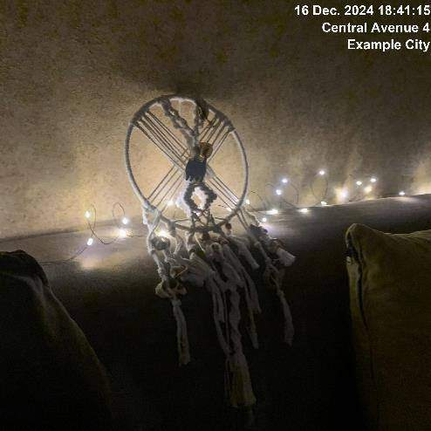
16.12.2024
Construction 1
Surface polishing required
16.12.2024
Construction 2
Surface polishing required

Slide 28
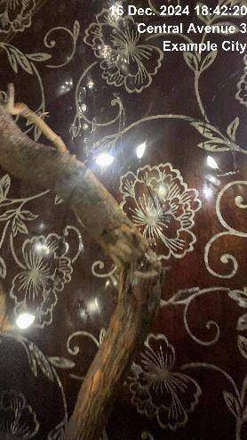
16.12.2024
Construction 3
Surface polishing required

Slide 29
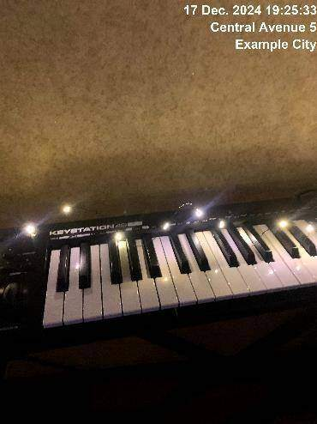
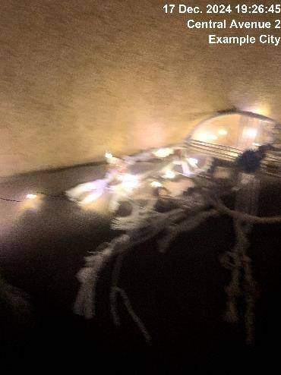
17.12.2024
Construction 1
17.12.2024
Construction 2

Slide 30
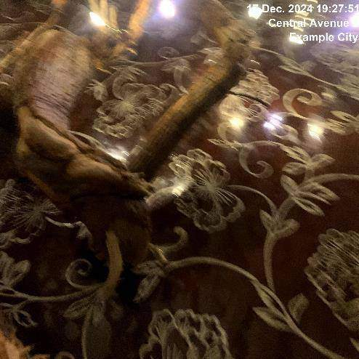
17.12.2024
Construction 3

Slide 31
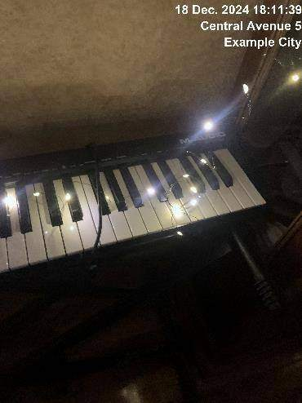
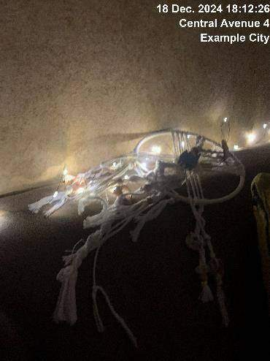
18.12.2024
Construction 1
18.12.2024
Construction 2

Slide 32
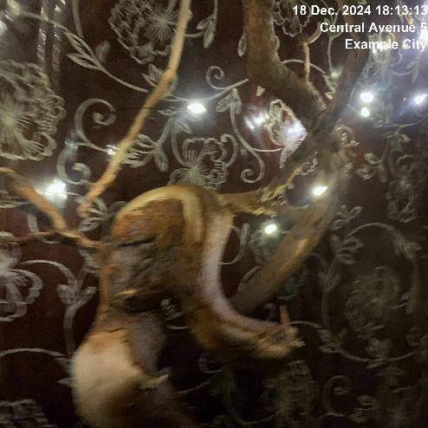
18.12.2024
Construction 3

Slide 33
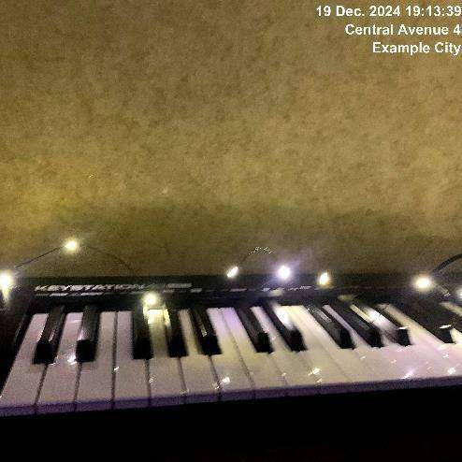

19.12.2024
Construction 1
Snow removal required
19.12.2024
Construction 2
Snow removal required

Slide 34

19.12.2024
Construction 3
Snow removal required

Slide 35
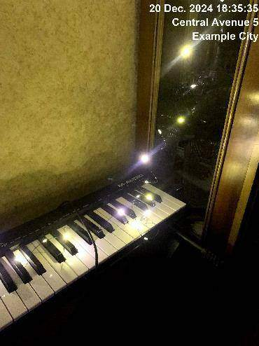
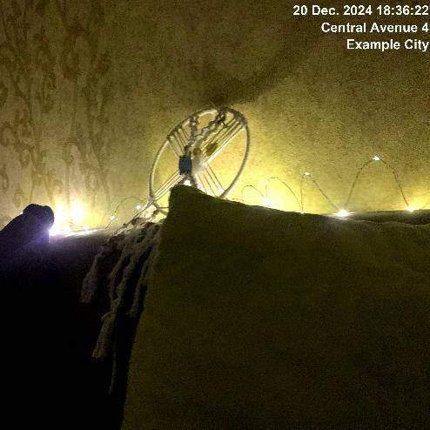
20.12.2024
Construction 1
20.12.2024
Construction 2

Slide 36

20.12.2024
Construction 3

Slide 37


21.12.2024
Construction 1
21.12.2024
Construction 2
Partical repair required

Slide 38

21.12.2024
Construction 3

Slide 39



22.12.2024
Construction 1
22.12.2024
Construction 2
22.12.2024
Construction 3

Slide 40


23.12.2024
Construction 1
23.12.2024
Construction 2

Slide 41

23.12.2024
Construction 3

Slide 42


24.12.2024
Construction 1
Surface polishing required
24.12.2024
Construction 2
Surface polishing required

Slide 43

24.12.2024
Construction 3
Surface polishing required

Slide 44



25.12.2024
Construction 1
Snow removal required
25.12.2024
Construction 2
Snow removal required
25.12.2024
Construction 3
Snow removal required

Slide 45


26.12.2024
Construction 1
26.12.2024
Construction 2

Slide 46

26.12.2024
Construction 3

Slide 47


27.12.2024
Construction 1
27.12.2024
Construction 2

Slide 48

27.12.2024
Construction 3

Slide 49



28.12.2024
Construction 1
28.12.2024
Construction 2
28.12.2024
Construction 3

Slide 50


29.12.2024
Construction 1
Deep inspection required
29.12.2024
Construction 2

Slide 51

29.12.2024
Construction 3

Slide 52


30.12.2024
Construction 1
30.12.2024
Construction 2

Slide 53

30.12.2024
Construction 3

Slide 54

31.12.2024
Construction 1
Surface polishing required

Slide 55


31.12.2024
Construction 2
Surface polishing required
31.12.2024
Construction 3
Surface polishing required

